Slide 1

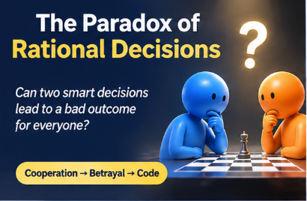

Game Theory / Human Behaviour / Artificial Intellegence
THE PRISONER'S DILEMMA
THE SCIENCE OF COOPERATION
Can two smart decisions lead to a bad result for everyone?
Kateryna Soloviova
COOPERATION - BETRIRAYAL - CODE

Slide 2

WHAT IS GAME THEORY ?
The study of decisions where the result depends on what other people do.
GAME THEORY
The study of strategic desicion
TWO PRISONERS * NO COMMUNICATION
MY CHOICE / OTHER
C COOPERATE
D BETRAY
The Prisonner’s Dilemma
Mathematical model developed by Merrill Flood and Melvin Dresher around 1950
C COOPERATE
3 / 3
0 / 5
D BETRAY
5 / 0
1 / 1
The Story
Dominant Strategy : Betray Nash Equilibrium: D/D 1 point each
Albert Tucker introduced the famous story of two prisoners
The paradox: two smart individual decisions create a worse result for both.

Slide 3
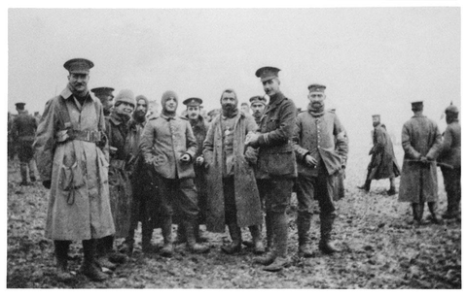
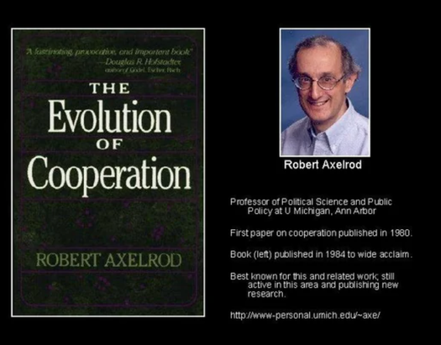
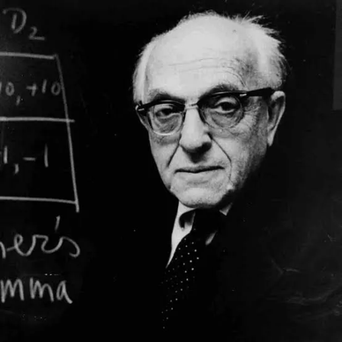
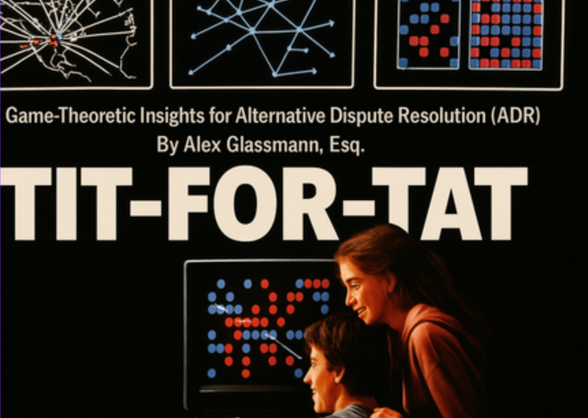
CAN COOPERATION BECOME A WINNING STRATEGY?
When players meet again, today's choice affects tomorrow.
1914
The Christmas Truce
Soldiers on opposing sides temporarily stopped fighting in some areas
1980s
Robert Axelrod
Computer tournaments: different strategies played against each other.
Anatol Rapoport
Submitted Tit for Tat Strategy
TIT FOR TAT
Cooperate first.
Then copy the last move

Slide 4
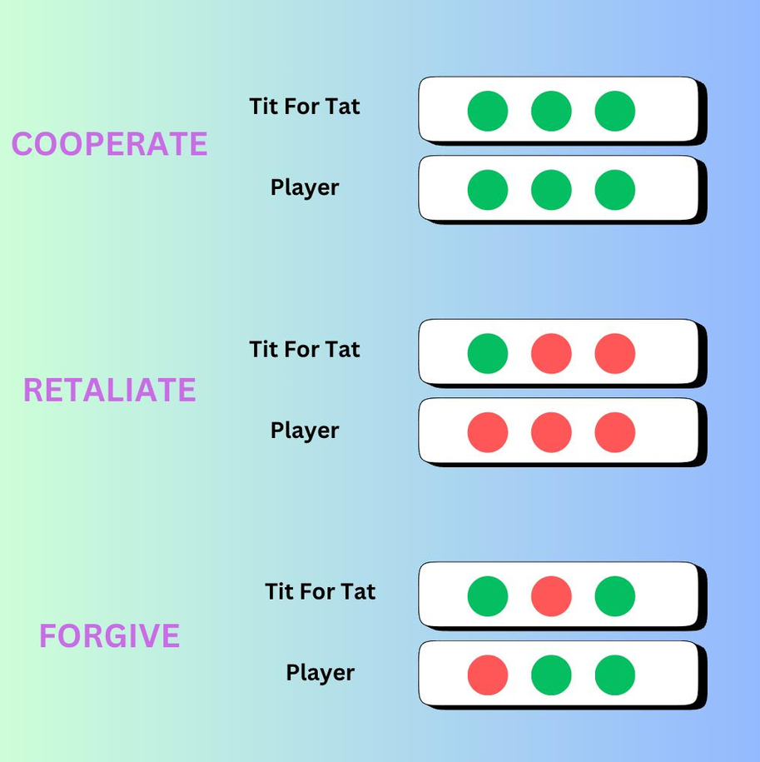


HOW DOES THE ‘TIT FOR TAT’ WORK?
The rule is simple: cooperate first, then copy the opponent’s last move
PYTHON
def tit_for_tat(opponent_moves):
if not opponent_moves:
return "C"
return opponent_moves[-1]
C = cooperate
opponent[-1] = the last move
NOISE:
one mistake can start endless revenge
Generous Tit for Tat:
sometimes forgive

Slide 5
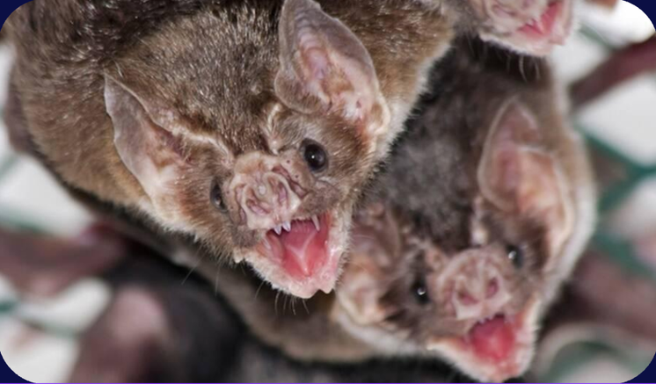
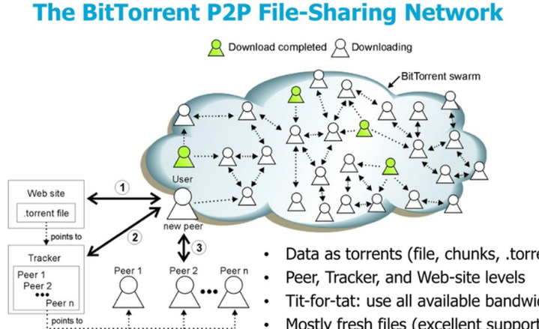

WHERE DOES COOPERATION WORK IN REAL LIFE?
The same principle of mutual help appears in nature and technology.
BIOLOGY
TECHNOLOGY
ARTIFICIAL INTELLIGENCE
Vampire bats share food with other bats.
They help each other because they may need help in the future.
BitTorrent is a file-sharing system.
Users share parts of files with each other. It is based on mutual contribution.
Modeling how autonomous agents choose to cooperate or compete based on others’ previous actions.

Slide 6

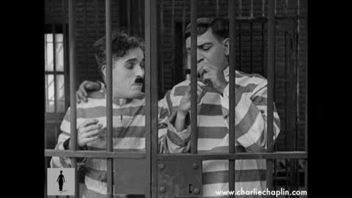
SOMETIMES, THE SMARTEST STRATEGY ISN'T TO WIN AGAINST EVERYONE.
IT'S TO LEARN HOW TO COOPERATE.
THANK YOU FOR YOUR ATTENTION!

